Slide 1

Market Mix Modelling (Adstock Optimization)
By Amit Yemul (1109959)

Slide 2
Table Of Contents | slide number
Introduction | 3
Problem Statement | 4
Requirements | 5
Data Collection and Understanding | 6
Solution Proposed | 7
Process followed | 8
Results | 16
Concepts Learned and scope | 17
References | 23

Slide 3
INTRODUCTION
What is marketing Mix Modelling:
Market Mix Modeling (MMM) is a technique which helps in quantifying the impact of several marketing inputs on sales or Market Share. The purpose of using MMM is to understand how much each marketing input contributes to sales, and how much to spend on each marketing input
Marketing inputs:
Promotional Events: Sales like Diwali Sales, Dassehra sale Etc.
Price Fluctuations :During promotional days and non-promotional days
Advertisement Activities :Amount of money spend on TV, Radio Ads etc
External Factors like seasonality of products

Slide 4
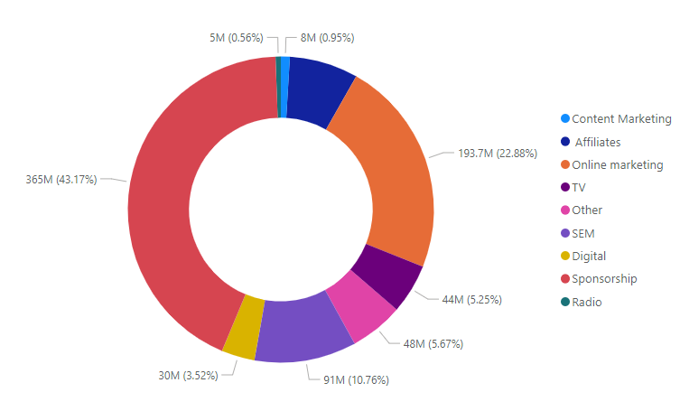
Problem Statement
ElecKart is an e-commerce firm based out of Ontario, Canada specializing in electronic products.
Following are investments in media activities:
Total Investment in media activities:846.50 Million
Total Revenue after media investment activities:2652.35 Million
Total Revenue during non media investment activities:460.52 Million
Increase in revenue due to media activities:2191.829210 Million (475.94%)
Return on investment:2.59
Problem Statement:.
Purpose of this project is to increase return on investment by decreasing Total Investment in media activities
.
Following image shows distribution of budget across different media activities

Slide 5
Requirements :
Softwares :
Jupyter Notebook
Power Bi.(For Visualization)
Language Used:
Python
Algorithms:
Multivariate Linear Regression
Modules used
Pandas
Numpy
StatsModel

Slide 6
Data Collection and Data Understanding
Source Of Data: https://www.kaggle.com/datatattle/dt-mart-market-mix-modeling?select=Secondfile.csv
Description Of Data:
Media Investment: This File Given information about Amount of Money Invested(in Millions) in Following Advertisement Activities on Monthly Basis and revenue generated in each month.
Data is available From:2015 January to 2016 December Total 2 Year Data is Available.
TV
Digital
Sponsorship
Content Marketing
Online Marketing
Affiliates
SEM
Radio
Others

Slide 7
Solution Proposed
To Know impact of different media activities on revenue (How much percent of revenue is generated by Running TV ads, Radio ads )
We can use multivariate linear regression by considering Following dependent and independent variables
Independent Variables:
TV
Digital
Sponsorship
Content Marketing
Online Marketing
Affiliates
SEM
Radio
Others
Dependent Variable:
revenue

Slide 8
Process
Add Lag, Carryover Effect, and Shape Effect (Find best value of decay and exponents)
Train The model , Get coefficients , Derive efficiency
Analyze Model results
Generate contribution chart
Decide Re-allocation strategy and predict revenue for re-allocated budgets
Calculate Return on investments

Slide 9
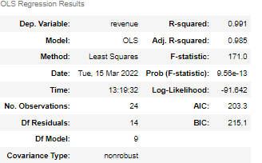
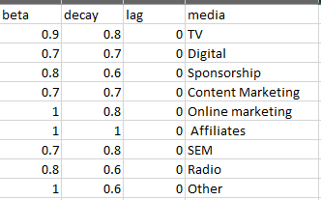
The Lag, Carryover Effect, and Shape Effect
Pls refer this link to know more about lag , carryover and shape effect
Lag=0
Beta=[0.6,0.7,0.8,0.9,1]
Decay=[0.6,0.7,0.8,0.9,1]
Run the model for above different values of beta and decay
Got best results for following values of lag beta and decay.
Results are shown below

Slide 10
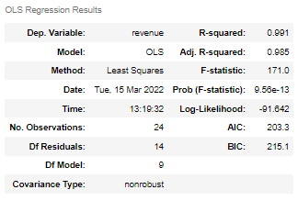
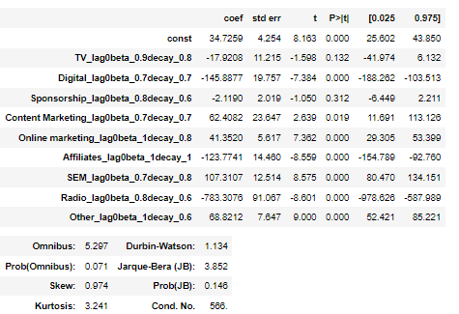
Train Model and analyze model results
As we can see revenue is inversely propotional
TV
Digital
Affiliates
Radio
Here
const=predicted revenue without investing in any media activities

Slide 11
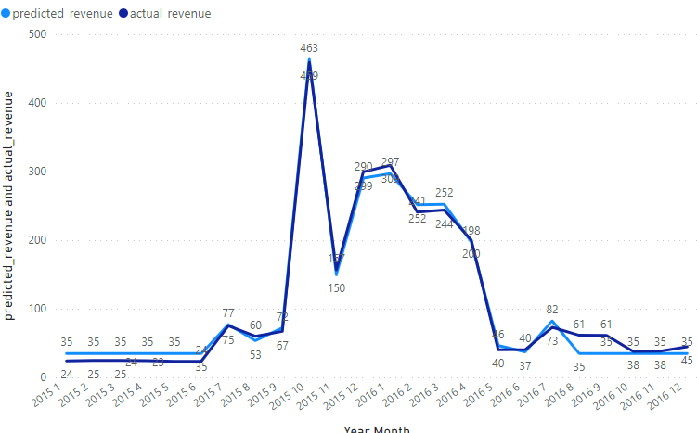
Plot actual vs predicted values of revenue.

Slide 12
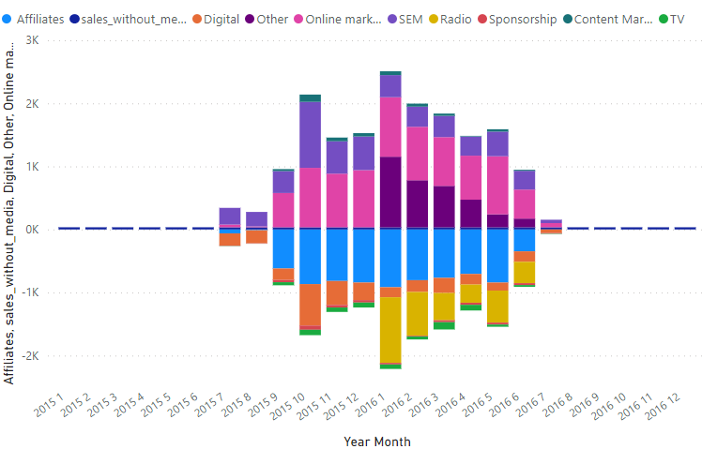
Contribution of media to revenue

Slide 13
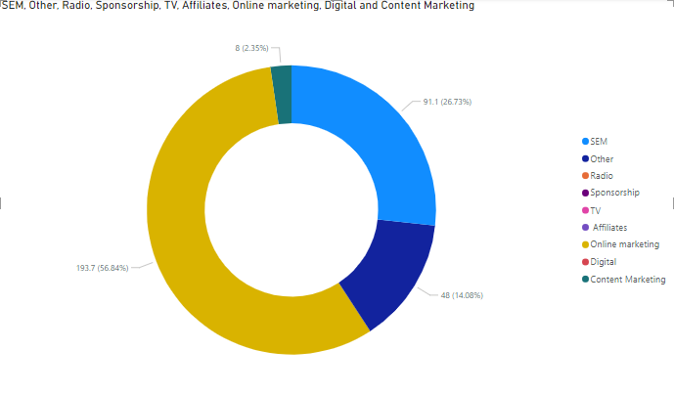
Reallocation strategy:
As we had Seen TV, Affiliates, Digital, Radio and Sponsorship This activities had inversely proportional to revenue
We will Re-allocate budgets from this activities into other activities like Content marketing, online marketing etc.
Original budgets
Re-allocated Budgets

Slide 14
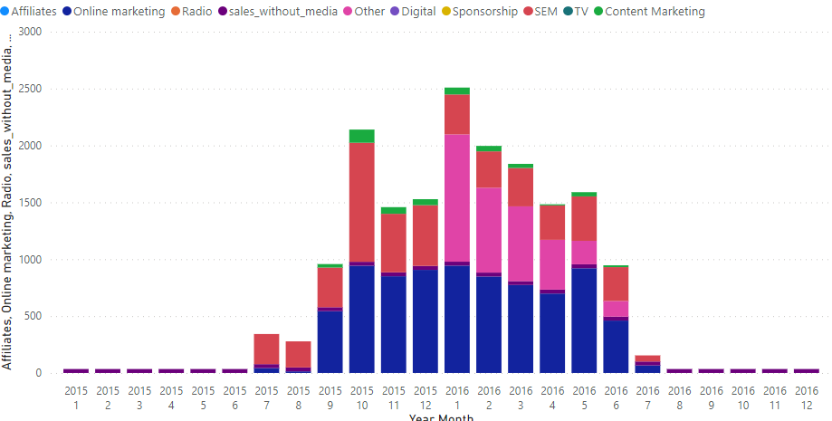
Contribution of media to revenue After budget re-allocation

Slide 15
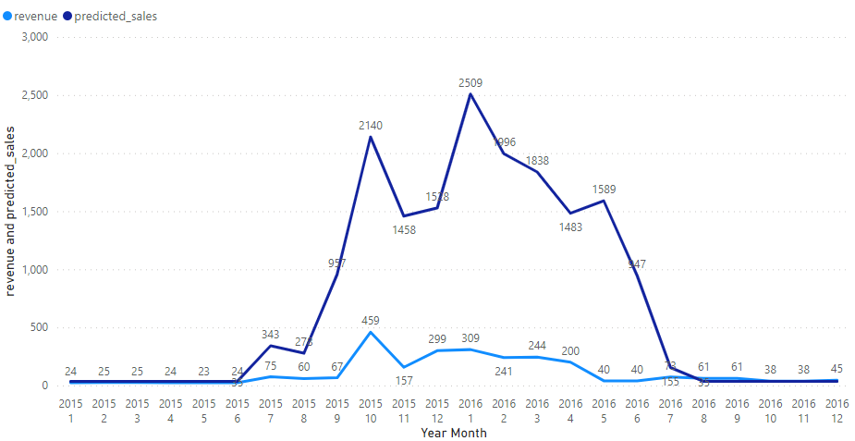
Predictions on re-allocated budgets

Slide 16
Results
Original Budgets :
Total Investment in media activities:846.50 Million
Total Revenue after media investment activities:2652.35 Million
Total Revenue during non media investment activities:460.52 Million
Increase in revenue due to media activities:2191.829210 Million (475.94%)
Results after re-allocation of budgets:
Total Investment in media activities:340.8 Million
Total Revenue after media investment activities:17601.35 Million
Total Revenue during non media investment activities:460.52 Million
Increase in revenue due to media activities:17141.5 Million (1500 %)

Slide 17
Concepts Learned
Marketing Mix Modelling
How Sales can vary by various factors
Multi-variate Regression
How to deal with Non-linear relationship between independent and dependent variables
Scope:
We can scale this project to forecast revenue for future years
We can plan our media budgets for future years

Slide 18
References
https://medium.com/analytics-vidhya/marketing-mix-model-guide-with-dataset-using-python-r-and-excel-4e319be47b4
https://www.kaggle.com/goyalshalini93/market-mix-model-eleckart#2.-Data-Cleaning-And-Preparation
https://towardsdatascience.com/market-mix-modeling-mmm-101-3d094df976f9

Slide 19
Thank You

